Slide 1


IoT Real-Time Water Quality Monitoring
Team Members:
Ahmed Osama
Alhassan Mohamed
Youssef Shabaan
Amr Mohamed

Slide 2
IoT Real-Time Water Quality Monitoring
Objective: Monitor and analyze water quality at Chicago beaches using real-time data from automated sensors.
Project Deployment:
Google Cloud Platform (GCP): Cloud-based, scalable infrastructure.
On-premise: Local processing for data storage and analysis.
Pipelines:
Real-time Monitoring Pipeline: Captures live sensor data every 30 seconds for immediate insights.
Long-term Analysis Pipeline: Stores and analyzes historical data for trends and predictions.

Slide 3
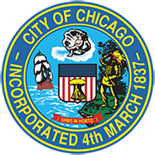
Dataset Overview
About this Dataset
Data Provided by: Chicago Park District
Dataset Owner: Jonathan Levy
Created On: May 15, 2014
Last Updated: September 21, 2024
Dataset Size
Total Rows: 45.8K
Total Columns: 10

Slide 4
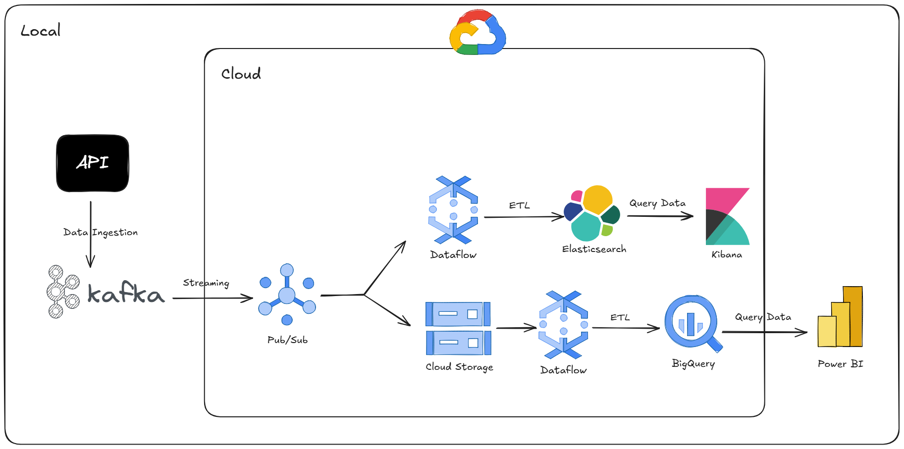
Cloud Architecture

Slide 5
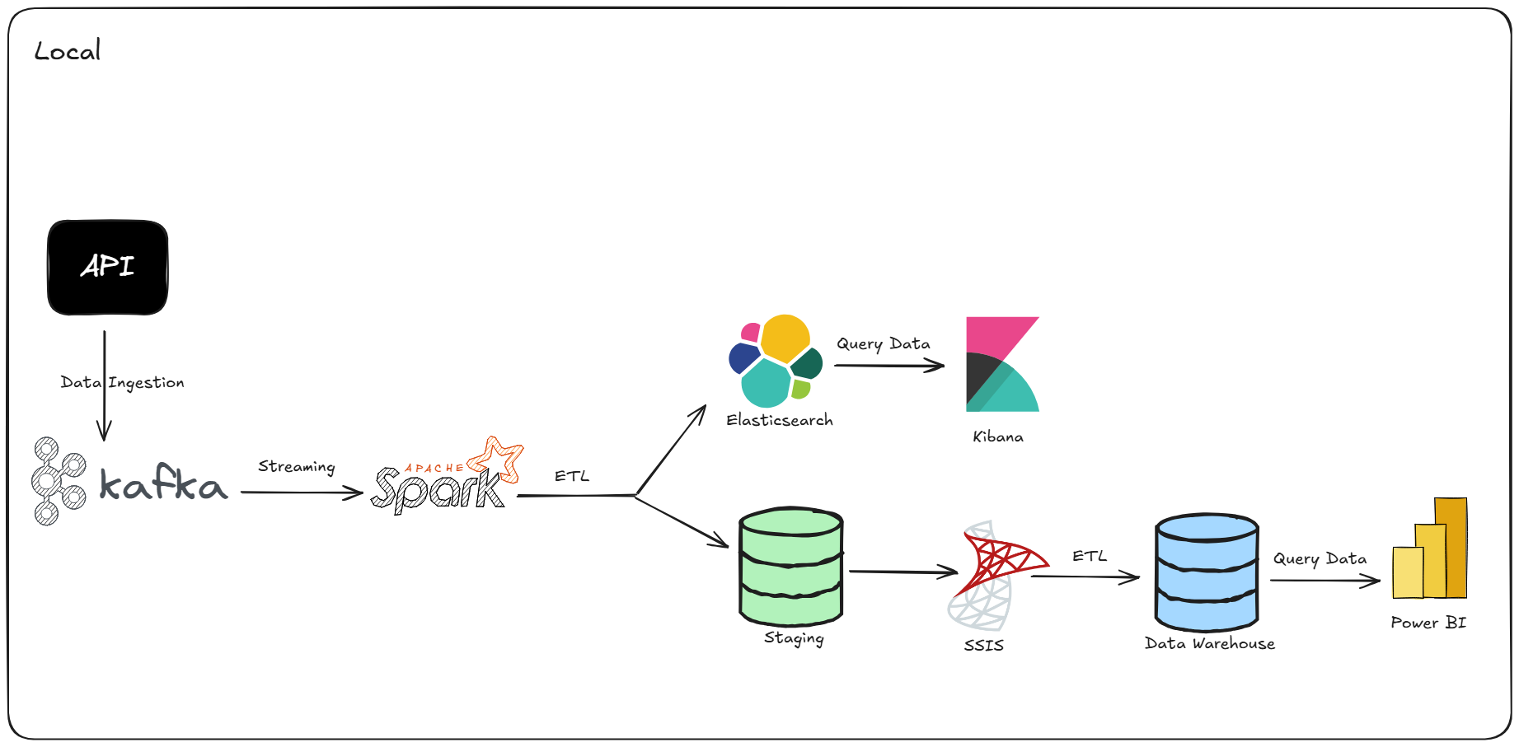
Local Architecture

Slide 6
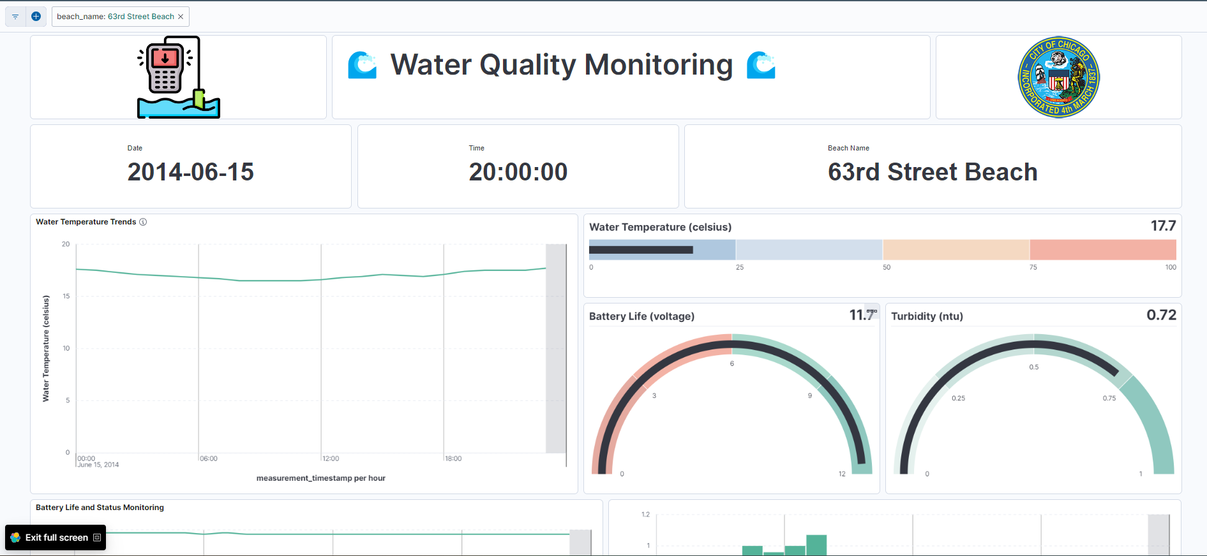
Kibana

Slide 7
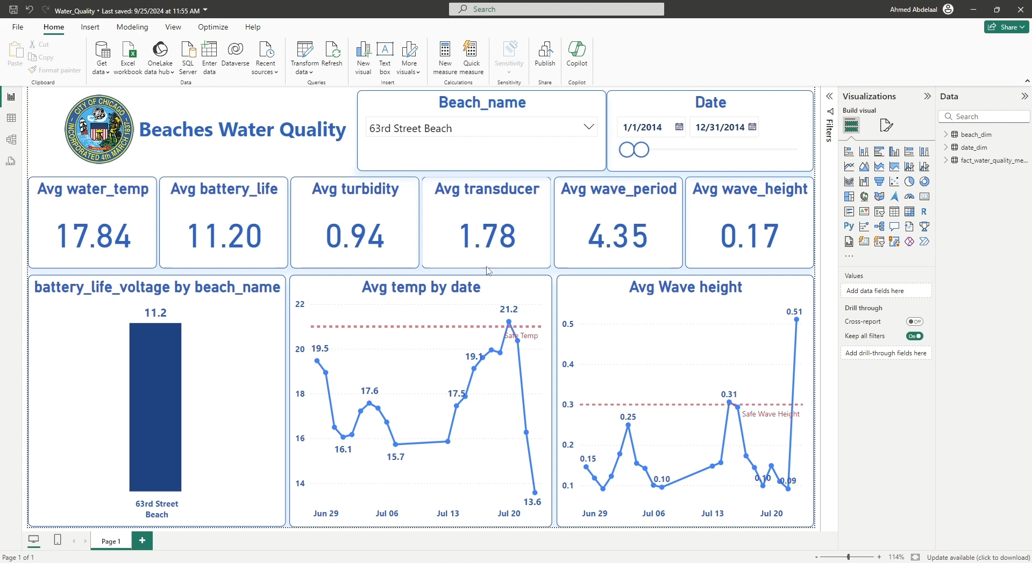
Power BI

